Slide 1
DEPARTMENT OF ECE
COURSE NAME – NETWORK PROTOCOLS AND SECURITY
COURSE CODE – 23EC2210
Topic:
ELEMENTARY DATA LINK PROTOCOLS, SLIDING WINDOW PROTOCOLS

Slide 2
AIM OF THE SESSION
To familiarize students with the basic concept of Elementary Data Link protocols
INSTRUCTIONAL OBJECTIVES
This Session is designed to:
Introduction to Elementary Data Link protocols
List out noisy and noiseless channels
Demonstrate protocols for noisy channel
Describe protocols for noiseless channel
Define sliding window protocols
LEARNING OUTCOMES
At the end of this session, you should be able to:
Define Elementary Data Link protocols
Differentiate noisy and noiseless channels
Summarize protocols for noisy and noiseless channels
Demonstrate sliding window protocols

Slide 3
AGENDA
Data Link Layer Protocols
DLL Protocols for Noiseless channels
​DLL Protocols for Noisy channels
Sliding Window protocols

Slide 4
Data link layer protocols
The most important responsibilities of the data link layer are framing, flow control and error control.
Data link layer protocols deals with flow control and error control.
Flow control refers to a set of procedures used to restrict the amount of data that the sender can send before waiting for acknowledgment.
Error control in the data link layer is based on automatic repeat request, which is the retransmission of data.

Slide 5
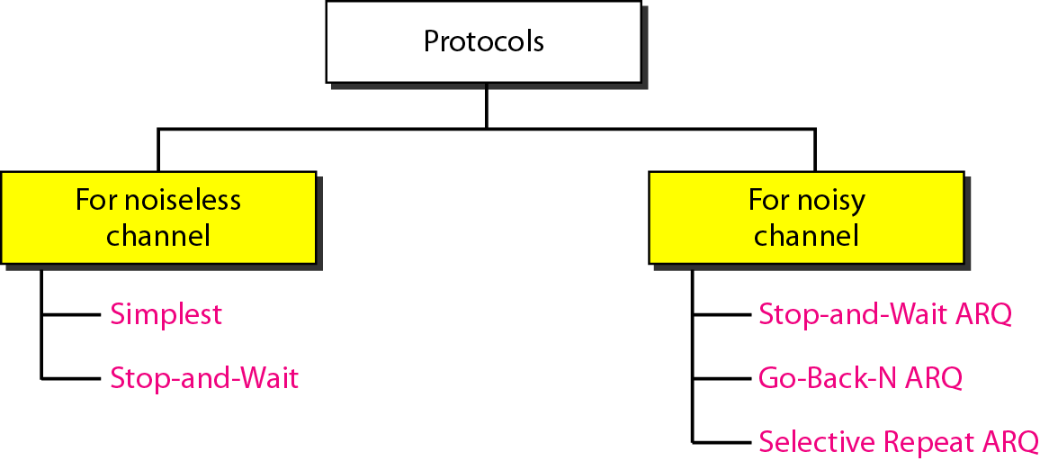
DATA LINK LAYER PROTOCOLS
The data link layer can combine framing, flow control, and error control to achieve the delivery of data from one node to another.
The protocols are normally implemented in software by using one of the common programming languages.

Slide 6
DLL PROTOCOLS FOR NOISELESS CHANNELS
Noiseless channel is an ideal channel in which no frames are lost, duplicated, or corrupted.
Two protocols for this type of channel.
Simplest Protocol
Stop-and-wait Protocol

Slide 7
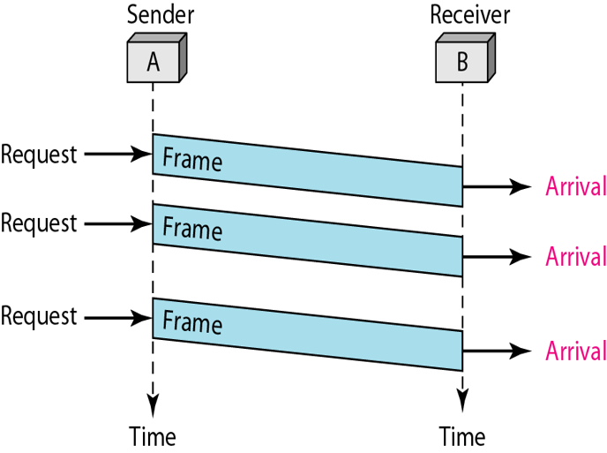
DLL PROTOCOLS FOR NOISELESS CHANNELS…
Simplest Protocol
Protocol with no flow or error control.
It is very simple.
The sender sends a sequence of frames without even thinking about the receiver.

Slide 8
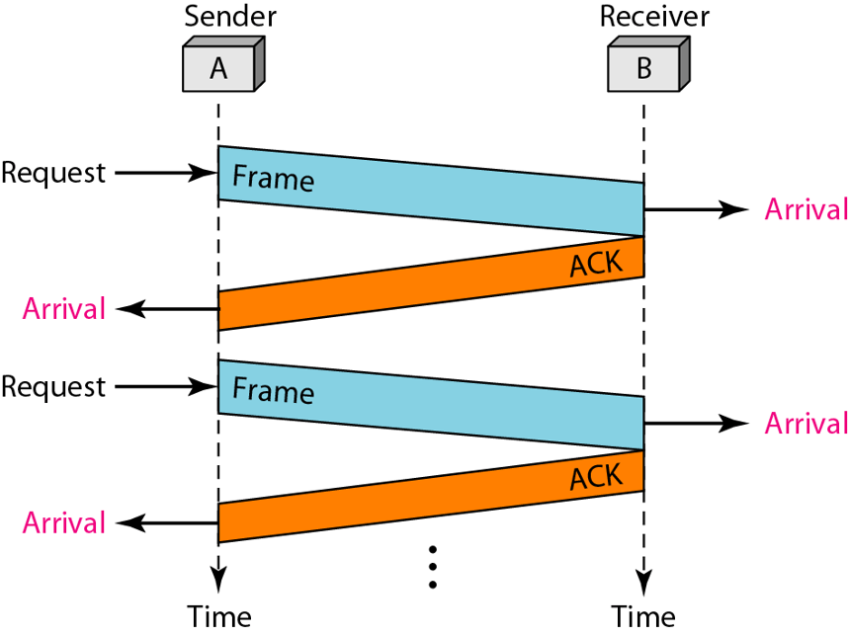
DLL PROTOCOLS FOR NOISELESS CHANNELS…
Stop-and-wait Protocol:
Protocol with flow control.
The sender will not transmit the next frame until it receives the acknowledgement of the last transmitted frame.

Slide 9
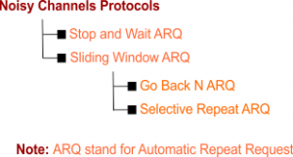
DLL PROTOCOLS FOR NOISY CHANNELS
Although the Stop-and-Wait Protocol gives us an idea of how to add flow control, noiseless channels are nonexistent.
Uses Sliding window protocols.
Follows Automatic Repeat Request (ARQ).
Adds Flow control and Error Control.

Slide 10
DLL PROTOCOLS FOR NOISY CHANNELS…
Stop-and-wait ARQ:
Stop-and-wait ARQ is a technique used to retransmit the data in case of damaged or lost frames.
This technique works on the principle that the sender will not transmit the next frame until it receives the acknowledgement of the last transmitted frame.

Slide 11
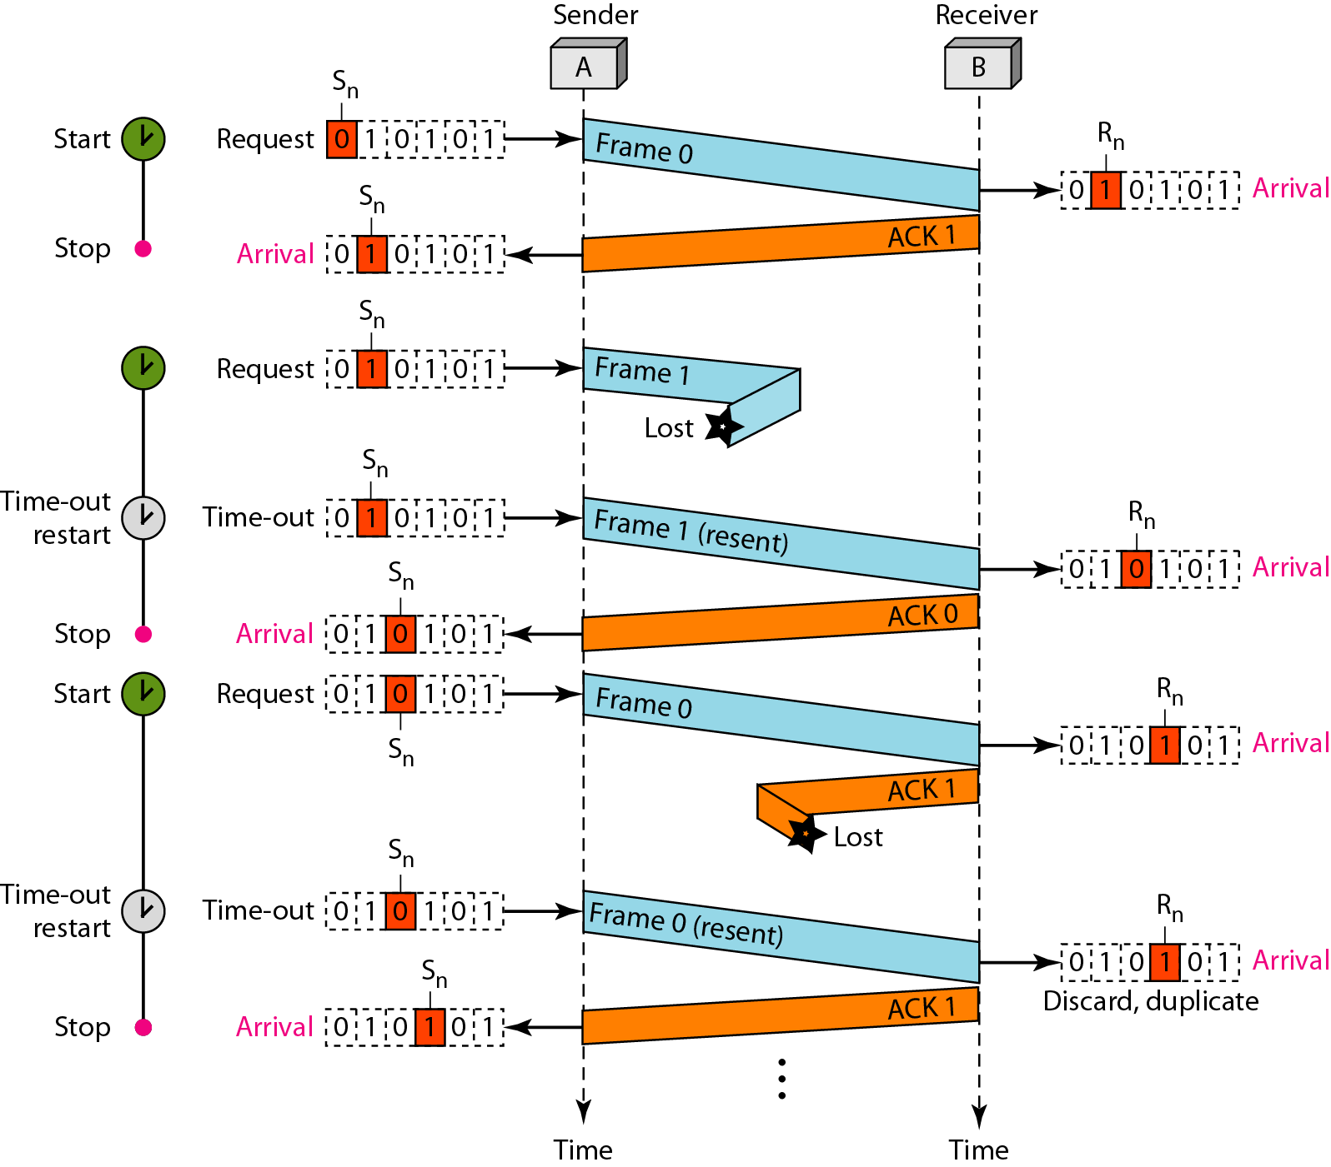
DLL PROTOCOLS FOR NOISY CHANNELS…
Stop-and-wait ARQ:
Possibilities of the retransmission:
Lost frame
Damaged Frame
Lost ACK

Slide 12
DLL PROTOCOLS FOR NOISY CHANNELS…
Advantage of Stop-and-wait:
The Stop-and-wait method is simple as each frame is checked and acknowledged before the next frame is sent.
Disadvantage of Stop-and-wait:
Each frame sent and received uses the entire time needed to traverse the link.

Slide 13
SLIDING WINDOW
Flow control method in which sender can transmit several frames before getting an acknowledgement.
Capacity of the communication channel can be utilized efficiently.
A single ACK acknowledge multiple frames.
Sliding Window refers to imaginary boxes at both the sender and receiver end.
The window can hold the frames at either end, and it provides the upper limit on the number of frames that can be transmitted before the acknowledgement.
The window has a specific size in which they are numbered as modulo-n means that they are numbered from 0 to n-1.
When the receiver sends the ACK, it includes the number of the next frame that it wants to receive.

Slide 14
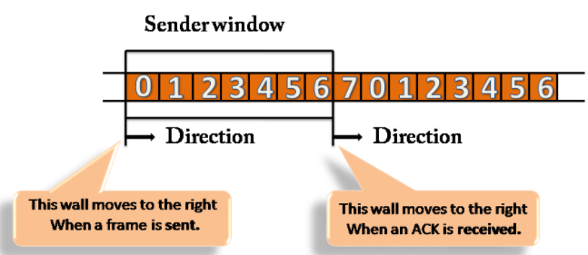
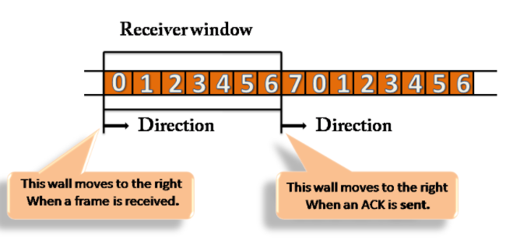
SLIDING WINDOW…

Slide 15
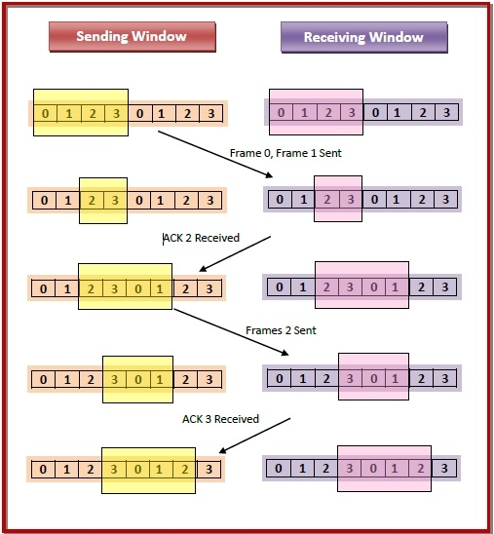
SLIDING WINDOW…

Slide 16
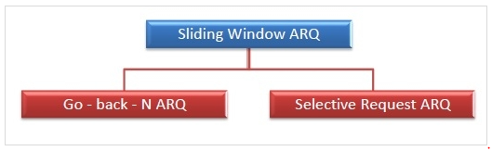
SLIDING WINDOW PROTOCOLS
Sliding Window ARQ is a technique used for continuous transmission error control.
Two protocols used in sliding window ARQ.

Slide 17
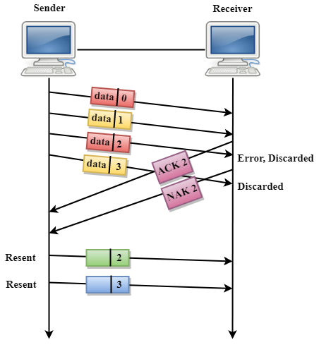
Sliding Window Protocols…
Go-Back-N ARQ:
In Go-Back-N ARQ protocol, if one frame is lost or damaged, then it retransmits all the frames after which it does not receive the positive ACK.
Three possibilities can occur for retransmission:
Damaged Frame
Lost Data Frame
Lost Acknowledgement

Slide 18
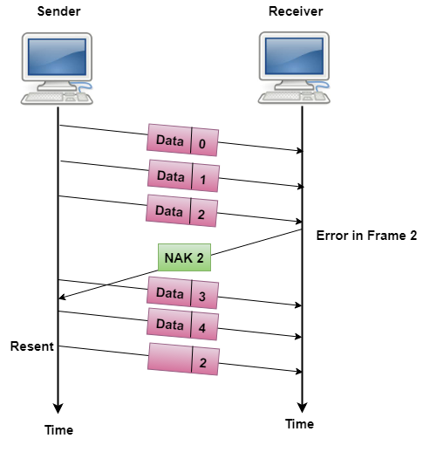
Sliding Window Protocols…
Selective Repeat ARQ:
More efficient than Go-Back-n ARQ.
Only those frames are retransmitted for which negative acknowledgement has been received.
The receiver storage buffer keeps all the damaged frames on hold until the frame in error is correctly received.
The receiver must have an appropriate logic for reinserting the frames in a correct order.
The sender must consist of a searching mechanism that selects only the requested frame for retransmission.

Slide 19
SUMMARY
Datalink Layer Protocols
DLL Protocols for Noiseless Channels
DLL Protocols for Noisy Channel
DLL Protocols for Noiseless Channels
Simplest
Stop-and-wait
DLL Protocols for Noisy Channels
Stop-and-wait ARQ
Go-back-N ARQ
Selective Repeat ARQ

Slide 20
REFERENCES FOR FURTHER LEARNING OF THE SESSION
TEXTBOOKS:
1. Data Communications and Networking(3rd Edition) – B A Ferouzan – TMH
2. Computer Networks (4th Edition) – A S Tanenbaum - Pearson Education/PHI
Reference Books:
Data Communications and Networking(5th Edition) – W. Stallings - Pearson Education/PHI
Network for Computer Scientists & Engineers, Zheng & Akhtar, OUP
WEB REFERNCES/MOOCS:
Kurose and Rose – “Computer Networking -A top down approach featuring the internet”– Pearson Education
“Communication Networks” – Leon, Garica, Widjaja TMH
“Internetworking with TCP/IP, Comer – vol. 1, 2, 3(4th Ed.)” – Pearson Education/PHI
https://www.tutorialspoint.com/what-is-closed-loop-congestion-control/
https://www.geeksforgeeks.org/congestion-control-techniques-in-computer-networks/3.

Slide 21

THANK YOU
NETWORK PROTOCOLS AND SECURITY

